Slide 1
i.Invest Competition Overview
Competition Overview
Six month program
Open to youth 13 -19 years old
Online scoring
Business concepts evaluated by top industry leaders
Virtual coaching & one-on-one mentoring
Connect with entrepreneurs from across the U.S.
Win up to $10,000 in cash/in-kind prizes & seed funding

Slide 2
i.Invest Timeline
Round 1 Scoring
May 15 – June 15
Virtual Group Coaching & One-on-One Mentoring
July 1 – August 1
Round 2 Scoring
August 10 – September 10
Finale Pitch Event
TBD

Slide 3
Competition Achievements-to-Date
2016
25 Applicants
6 Finalists
Top winner raised $250K in pre-seed capital / hired staff
2017
33 Applicants
5 Finalists
Top winner recognized by media / increased subscribers to APP / expanded services
2018
45 Applicants
8 Finalists

Slide 4
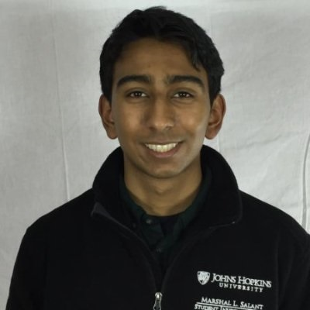
2016 Winner
​
Shrenik Jain, Co-Founder, Beacon Health, 19 - Baltimore, MD
Beacon Health is a mobile platform that offers anonymity and support to those suffering from mental health issues.
"The i.Invest competition was an invaluable experience for our team. The mentorship we received from experts all across the country gave us insights we would have never come up with during a critical phase of our business."

Slide 5
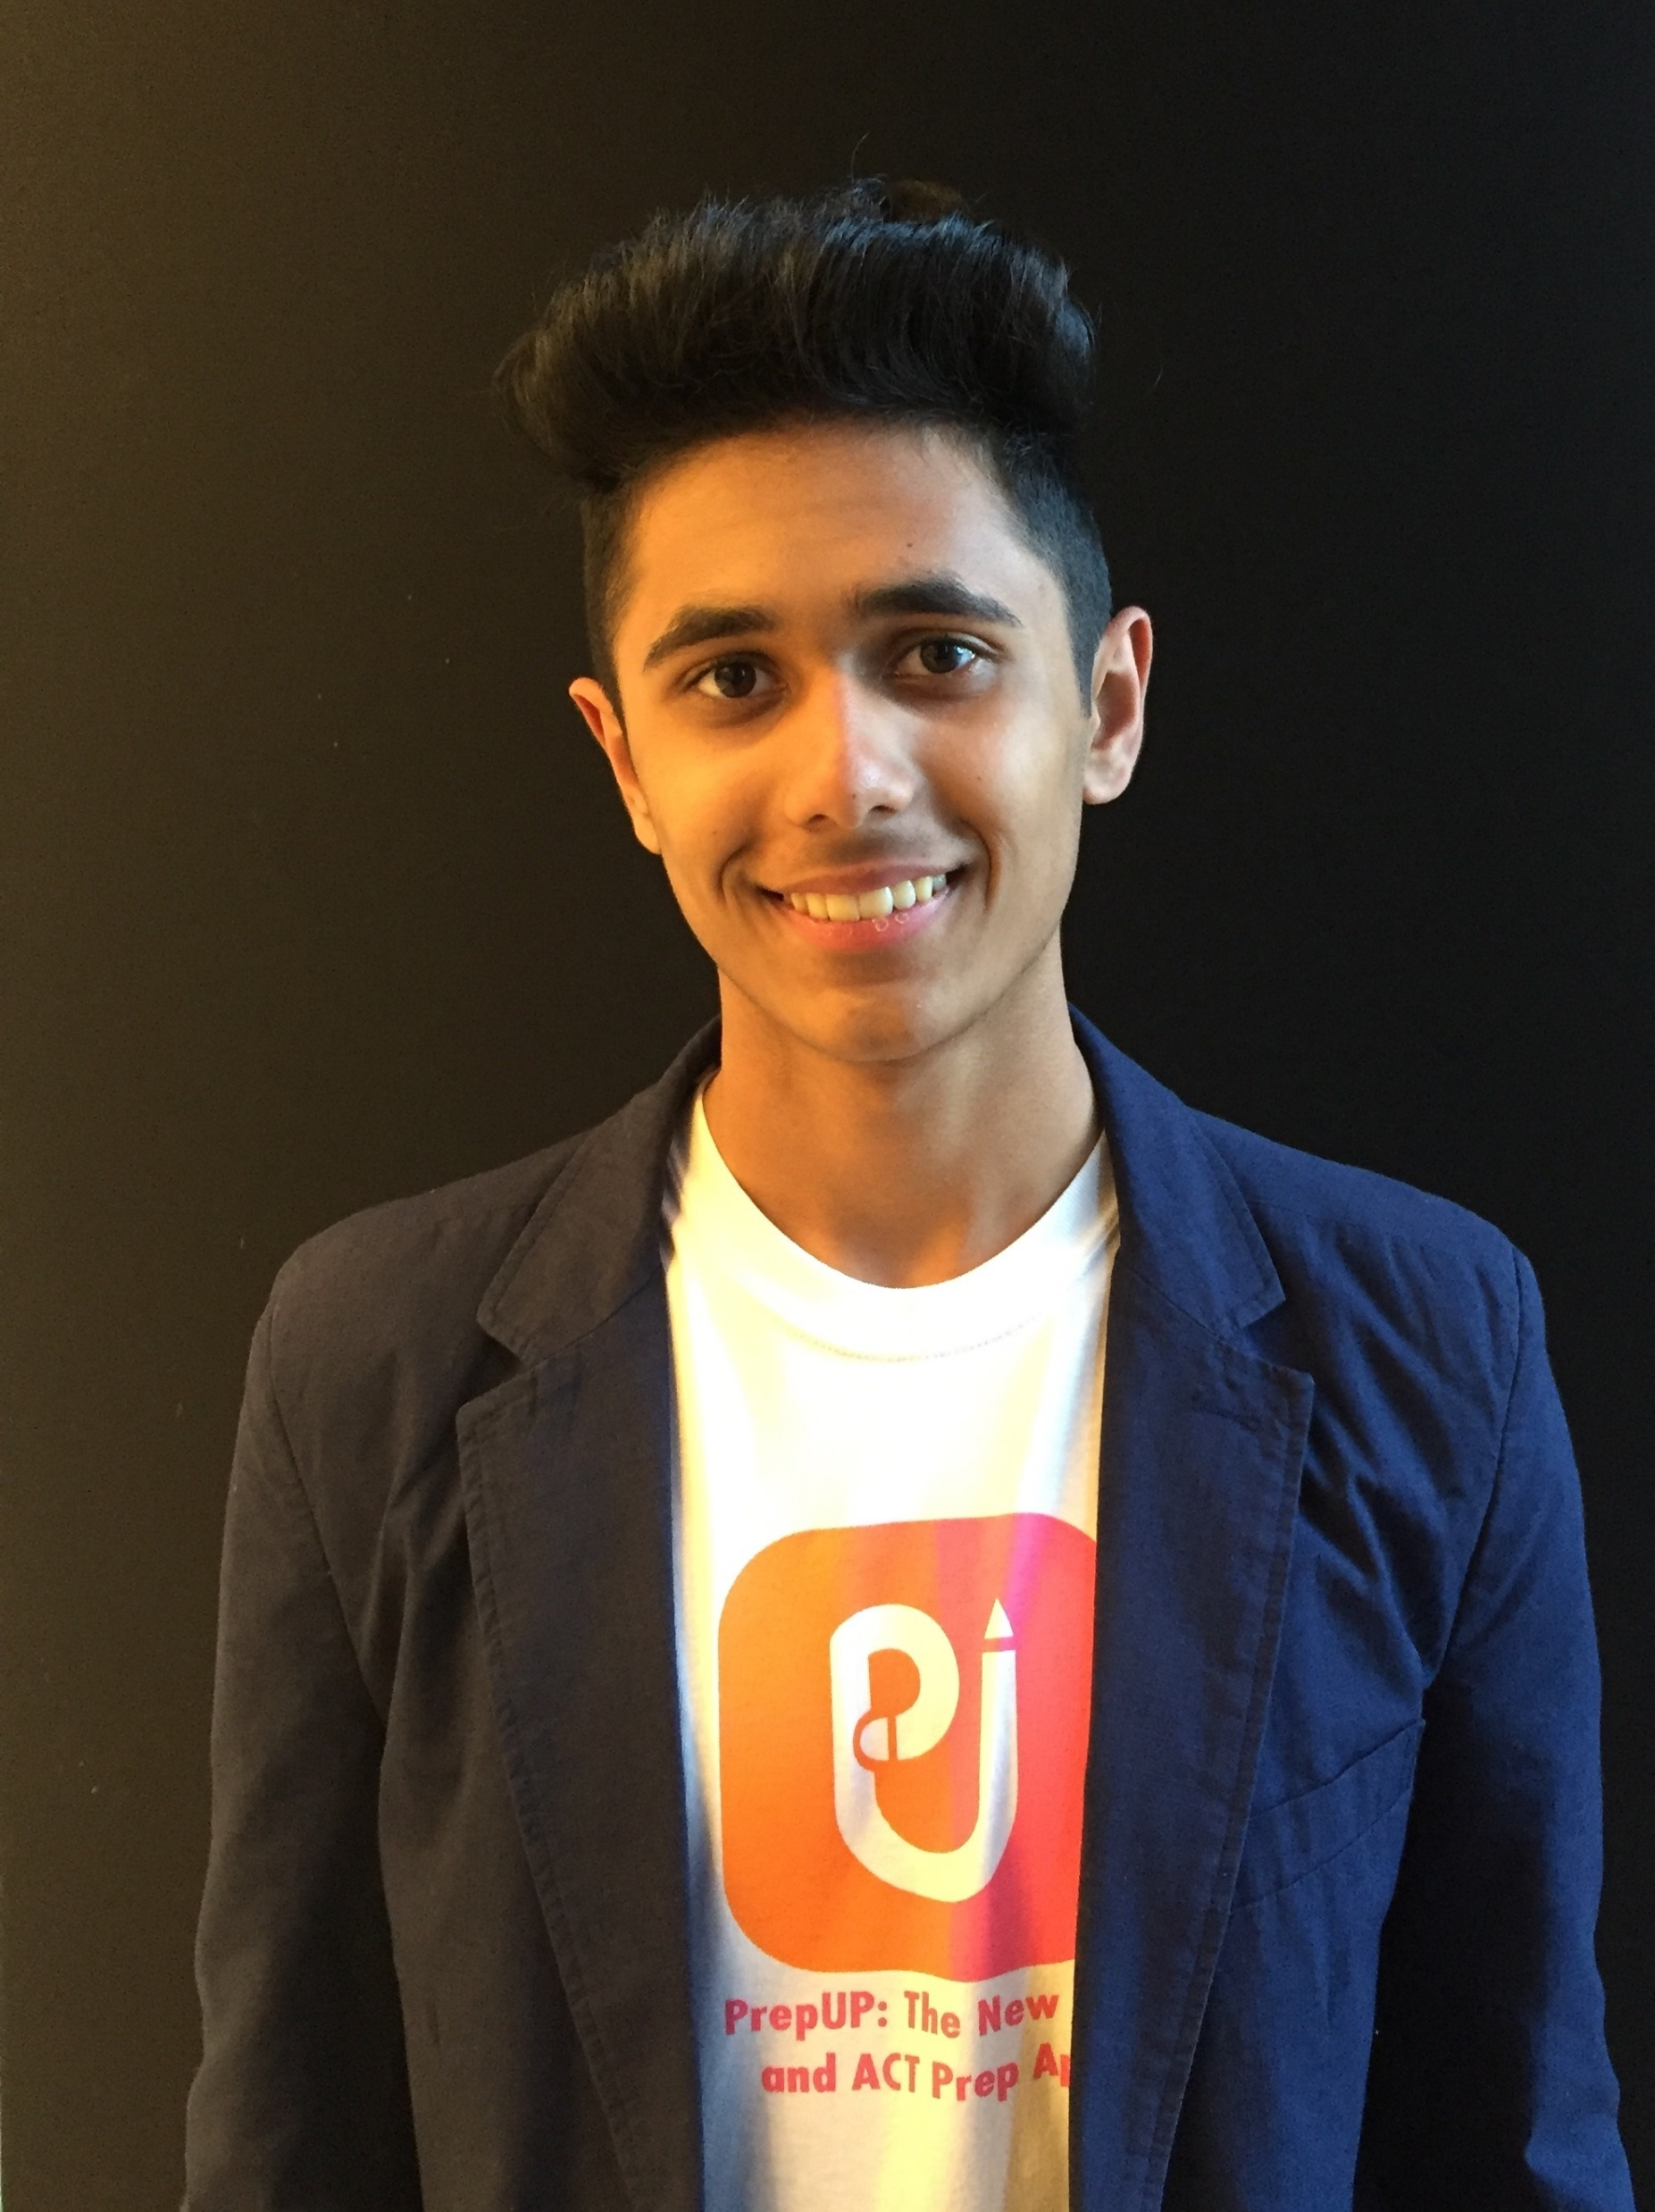
2017 Winner
​
Akhilesh Khakhar, 17, Founder, PrepUP SAT & ACT College Prep App – New York, NY
PrepUp is a free test preparation app that brings students together on social media platforms to study for the SAT and ACT college preparatory exams. The app offers an interactive, live, head-to-head match between its users.
“The i.Invest competition was an amazing learning experience. What really makes it different is that, over the course of six months, the companies progress and iterate while being guided by mentors. i.Invest provides the mentorship and feedback young start-ups need when they are initially pivoting and choosing a track to follow.”

Slide 6
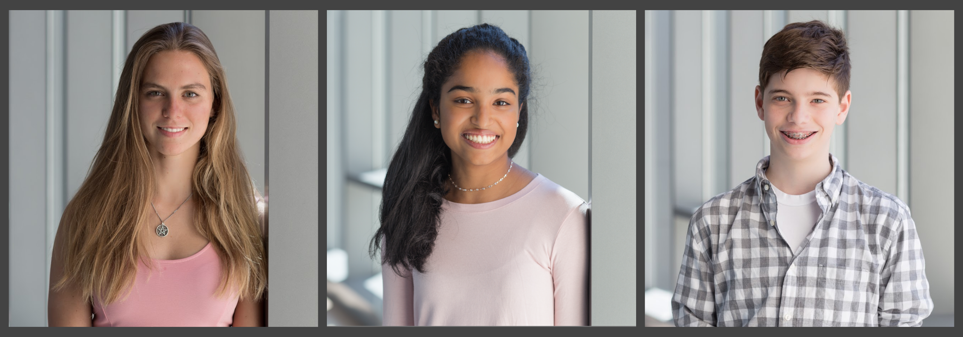
2018 Winner
​Richa Krishna, 17, of Los Altos, CA, William Barkoff, 16, of New York, NY and Anna Pertl, 17, of Munich are the founders of Pulse Wearables
The Pulse Wearables' medical device allows people limited by heart conditions to monitor their heart rate levels using a non-invasive patch that is easy to use, inconspicuous, and does not require any companion devices to operate. Prize: $2,000, title of i.Invest 2018 Youth Business of the Year, and a one-hour consulting session with Don Morrison, serial entrepreneur and chairman of deal flow at BlueTree Allied Angels and former President and CEO of American Eagle Outfitters.
"The i.Invest competition was a wonderful experience," said Pulse Wearables co-founder, Krishna. "We loved the mentorship we received from several business leaders both through one-on-one and group sessions. It helped us identify what is truly essential in building our business and focusing on our goals. I also appreciate how well i.Invest was organized and how smooth it was for young entrepreneurs from all over the country to participate. I would love to thank everyone who was part of i.Invest for providing a supportive environment for young entrepreneurs like myself to try without fear of failure."

Slide 7
Become a Cash or In-Kind Sponsor
Getting involved
Donors are asked to give in one of the following ways:
Become a principal sponsor of the program
Sponsor a youth to compete at $29
Sponsor an in-kind prize (ex. Professional services, consulting, etc.)

Slide 8
What’s New
i.Invest Partners with Idea network
Idea Network creates private networks for universities and other established organizations including Stanford, IBM, BMW, and Teen Entrepreneurs. We will use it to allow young startup companies to find teammates to help them bring their ideas to life.
The Network is designed for passionate entrepreneurs who have the problem of building a team with the necessary skills they need.
IdeaNetwork.us

